Slide 1

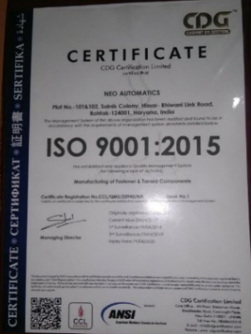


Slide 2

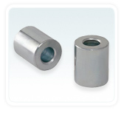
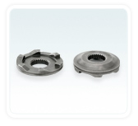
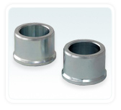
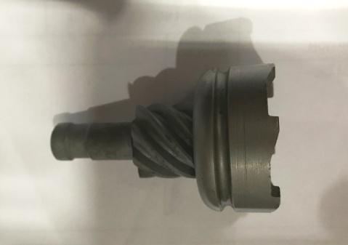
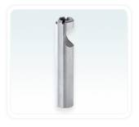
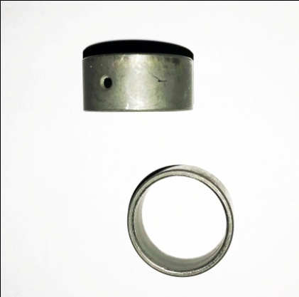
Coller RR Panel Side
Ratchet Starter
Coller RR Wheel Side.
Ratchet pinion Assembly
Rocker Arm
Bush 20 X 9

Slide 3
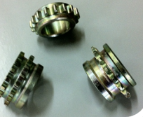
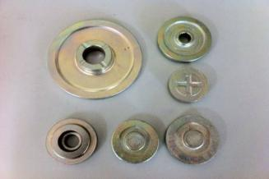
Sprockets
Gear Blanks
Bush 20 X 9
Ratchet pinion Assembly
Rocker Arm

Slide 4
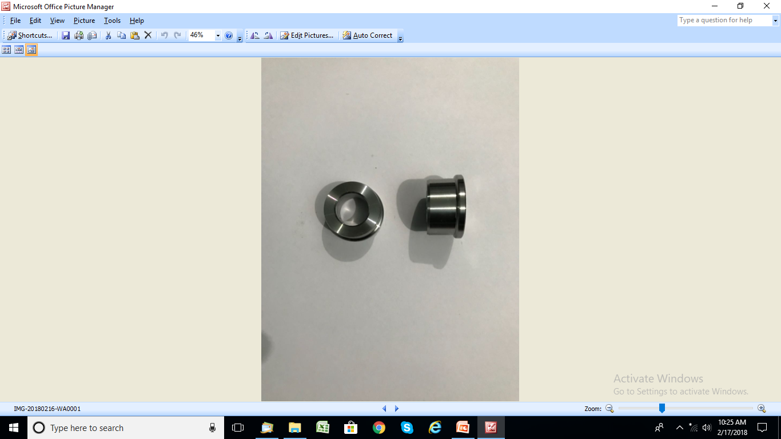
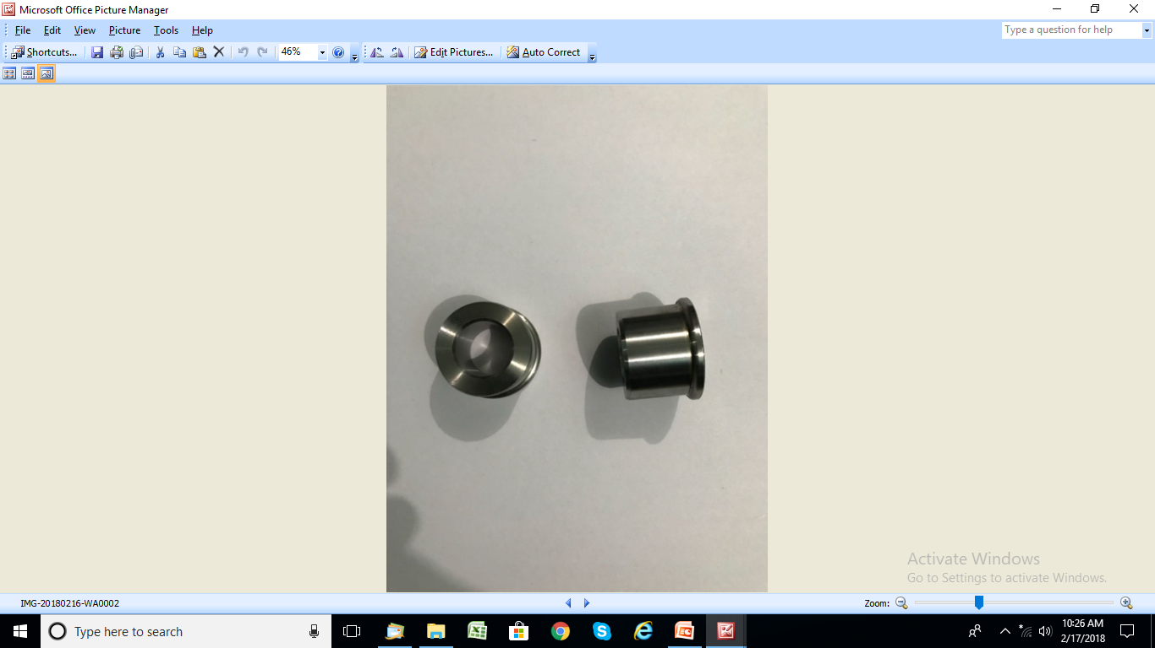
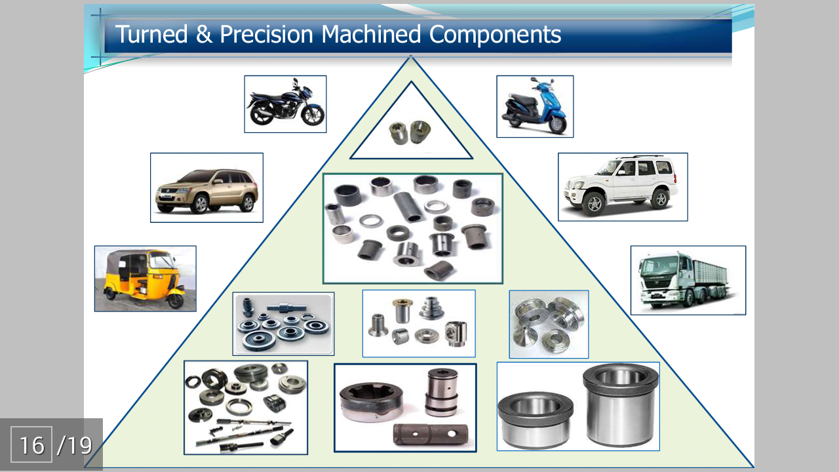
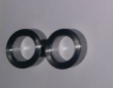
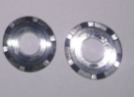
Coller L RR Wheel Side
Coller R RR Wheel Side
Engine Bushes
Ratchets Blanks

Slide 5

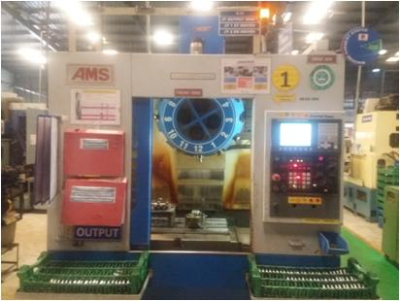
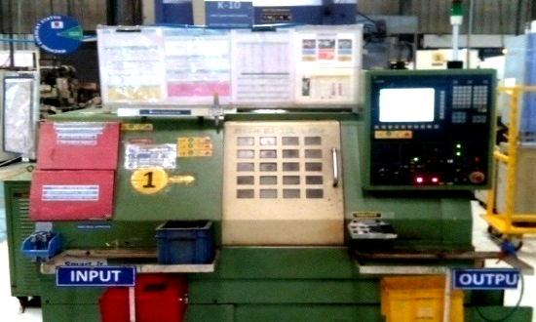
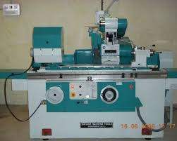
CNC MACHINE 22
TRAUB MACHINE A30,A25 15
TRAUB MACHINE A42,A60 9
CENTER LESS GRINDER 2
DRILL MACHINES 6
VMC
CNC TURNING
Cylindrical Grinding

Slide 6
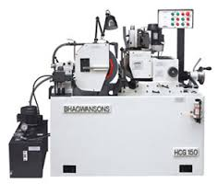
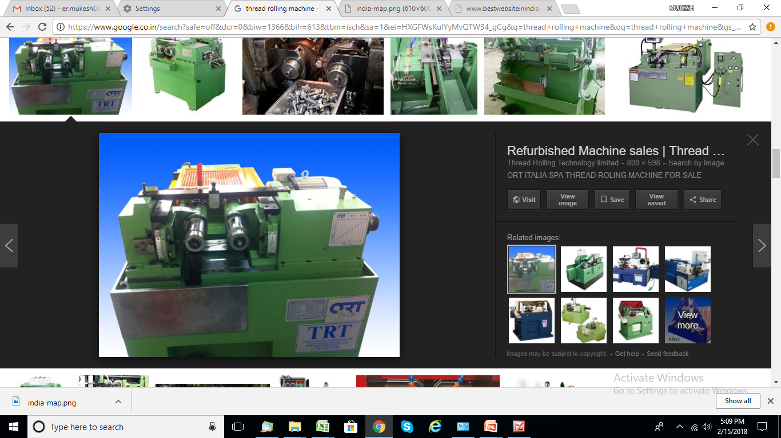
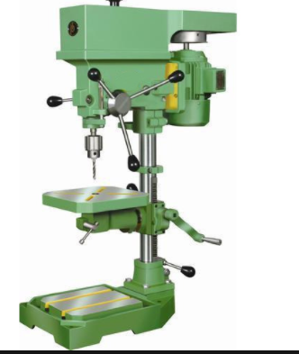
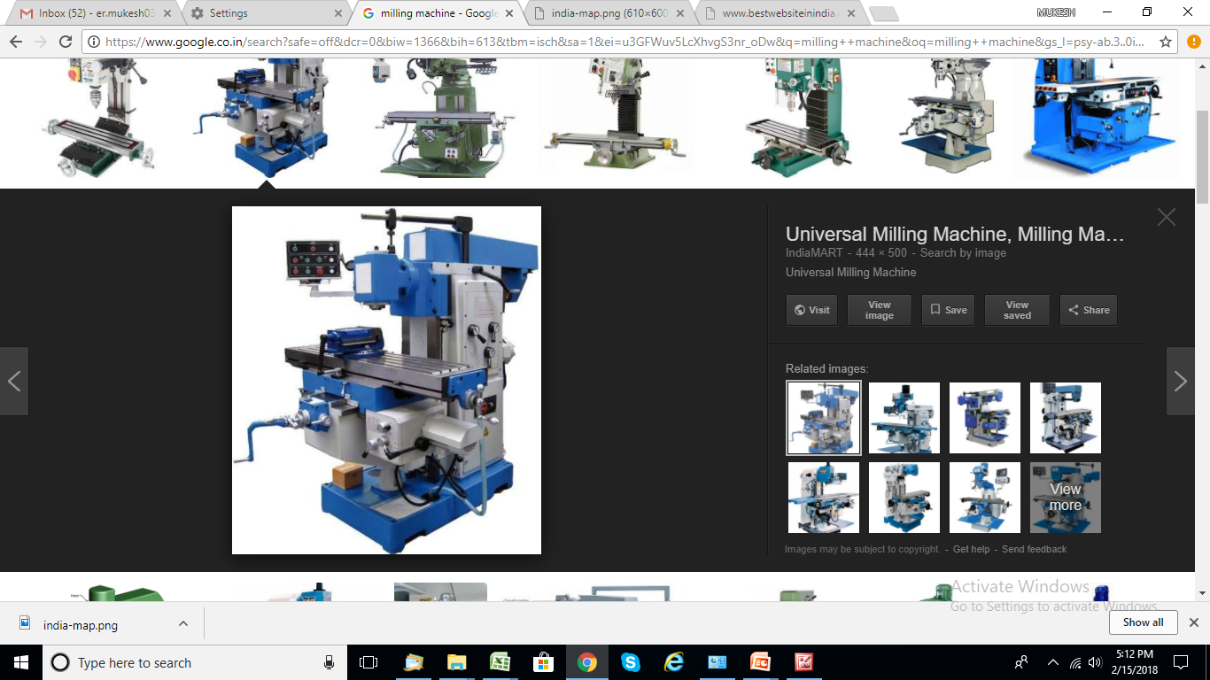
STRAIGHTENING MACHINE 1
SERRATION ROLLING MACHINE 2
SURFACE MACHINE 1
TAPING DRILL MACHINE 2
MILLING MACHINE 2
LATHE MACHINE 2
AIR COMPRESSUR 2
DIESEL GENSET(150KVA+85 KVA,45 KVA 2
Centreless Grinding
Thread Rolling
Drilling & Milling

Slide 7

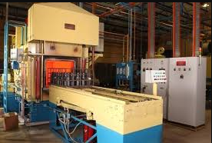
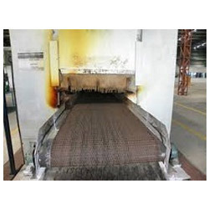

Sealed Quench Furnace
Mesh Belt Furnace

Slide 8
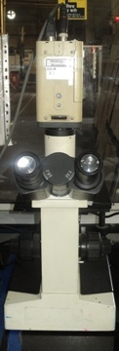
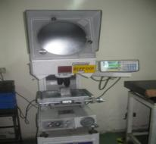
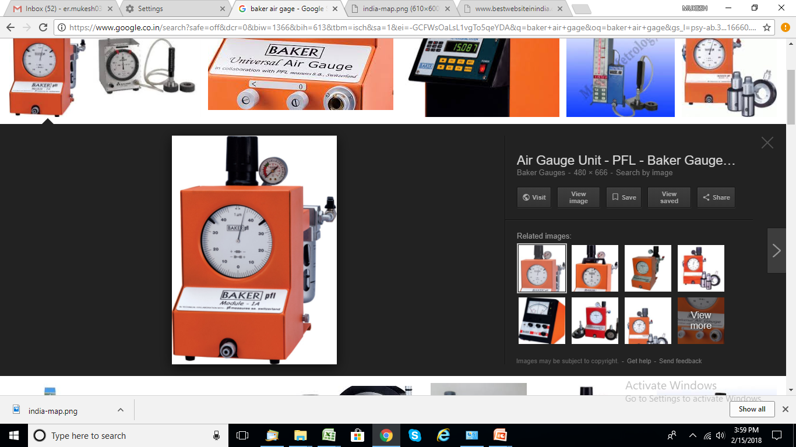
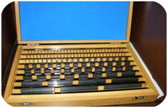
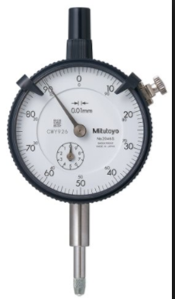
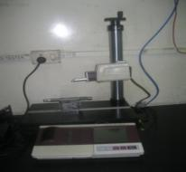
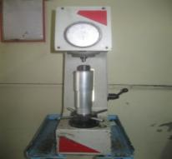
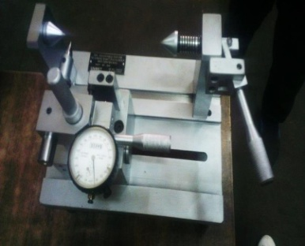
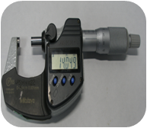
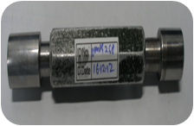
INSPECTION & TESTING EQUIPMENTS
Digital micrometer | Plunger Dials (0.001mm)
Profile Projector | Lever Dials (0.001 mm)
Surface Roughness Tester | Air Ring/Plug gauges
Digital Vernier Calipers | Polishing & Mounting Machine
Rockwell Hardness Tester | Height Gauge
Metallurgical Microscope | Digital height gages
Microscope
Profile Projector
Slip Gage Box
Air Gages
Dial Indicators
Roughness
Tester
Digital Micrometer
Special
Gauge

Slide 9
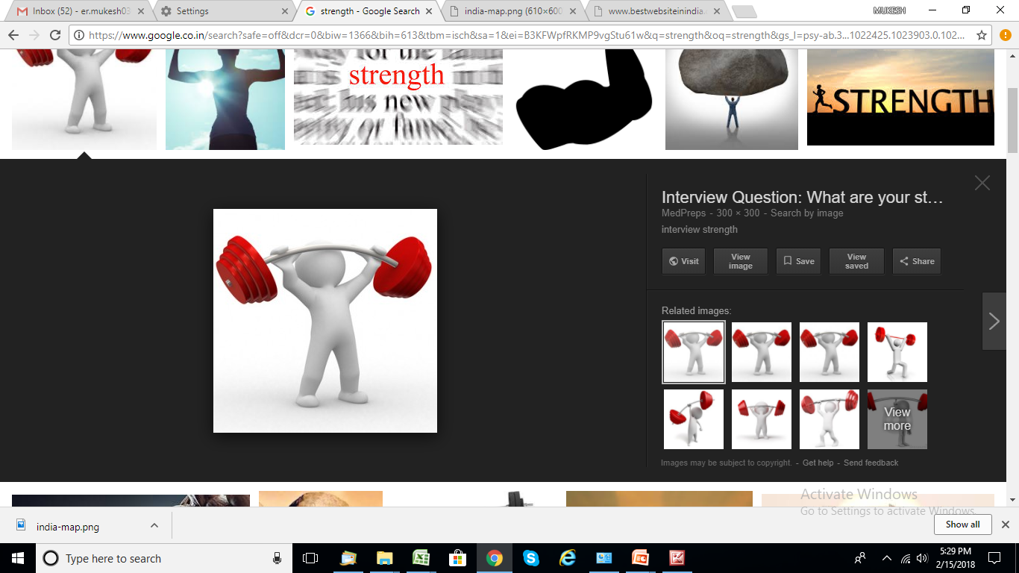
Turning, Milling, Grinding & Drilling in the same premises
Facility to produce Precision Machined Components
Ability to handle Carbon / Alloy / Stainless steel for various products and applications
Ability to develop new components in short time

Slide 10

Best in class technology to provide best quality product at lowest price.
Multi location plant and also have back up for each location in case of need with spare capacity.
Follows culture of Kaizens and continual improvements.
All facilities developed under one roof.
No IR issues & No union PROBLEMS.
Low cost & High volume supplier.
Preferred source of all OEMs.
Highly competent & experience team

Slide 11

Unit - I
Neo Automatics
Plot No.101 & 102 , Sainik Colony,Hissar Road,
Rohtak – 124001 (Haryana), India
Ph.: 9896251170,9896277161
Email: neo.automatics@gmail.com
Unit- II
Kitchen Tools
Dobh
Bhiwani Road ,Rohtak (Haryana )
Ph.: 9416050367
Email: rkmal123@gmail.com
Unit- III
Neo Turner
Plot No. -10, Sector 31,B
IMT , Rohtak (Haryana )
Ph.: 9896251170
Email: neo.automatics@gmail.com

Slide 12


